Slide 1
SUICIDE RATE IN 1985 - 2016
Exploratory Data Analysis
Insight full data with visualization.
Reporter: Enggar Kristian

Slide 2
Contents
| Text
01
Introduction
02
Data Loading
03
Exploratory Data Analysis
3.1
Average suicide rate for each country.
3.2
Age Group
3.3
About Generations
3.4
Gender
3.5
Economics Data

Slide 3


01
Enggar Kristian
Data Science
Data Engineer
Data Analytics
Bussiness Intelligence Analysis
Github
LinkedIn

Slide 4




02
Data Loading
Python
Infromation of Data
Analysis
Matplotlib and Seaborn Libraries
We want to know what the inside of dataset with data.info()
Dataset has been ready for Exploratory Data Analyisis
Clean the Dataset
Load the Dataset
There is a missing values in HDI for year column contains 69.9%
Suicide.csv

Slide 5

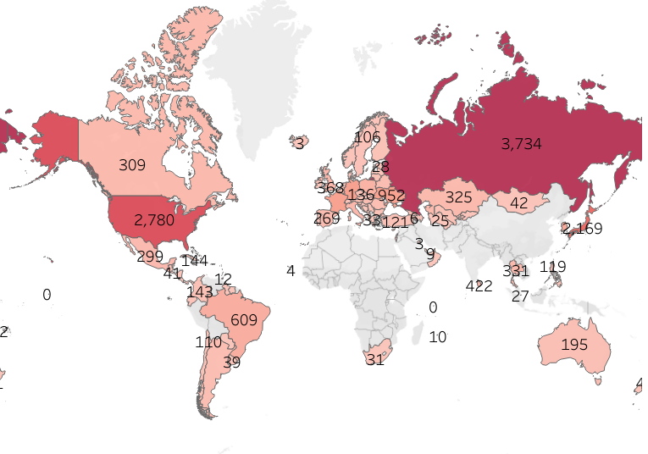
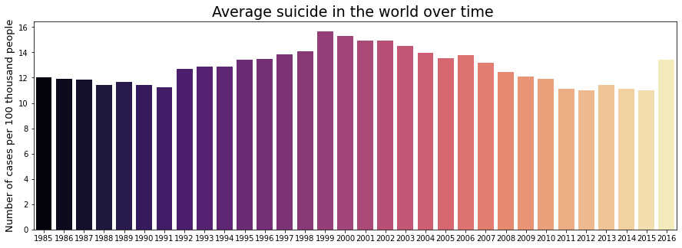
03
Exploratory Data Analysis
Note: Better you zoom of the graphs
As we can see from map output that Russian Federation, USA, Japan has highest number of suicide rates of more than 2k and Russian Federation. They are indeed known as developed countries, but they are comparable to the occurs in these countries where the results they produces are also of high quality.
Let's look at the graph of the average suicide rate worldwide from 1985 - 2016 which was the highest in 1999. Rate was 59.18 per 100,000 inhabitants in 1985 to 77.45 per 100,000 inhabitants in 2015, growing by approximately 30.87%, an approximate average of 1.03% per year.
On the other hand, the global suicide rate has been decreasing over time, but it has not always been so. From 1985 to 1995 the number of suicides per 100 thousand inhabitants grew by about 115%, but this soon changed, reaching a reduction of approximately 85.35% in the numbers between 1995 to 2015, approximately 4.26% per year. Over the 30 years analyzed, the reduction rate was 68.47%, approximately 2.30% per year.
3.1
Average suicide rate for each country.

Slide 6
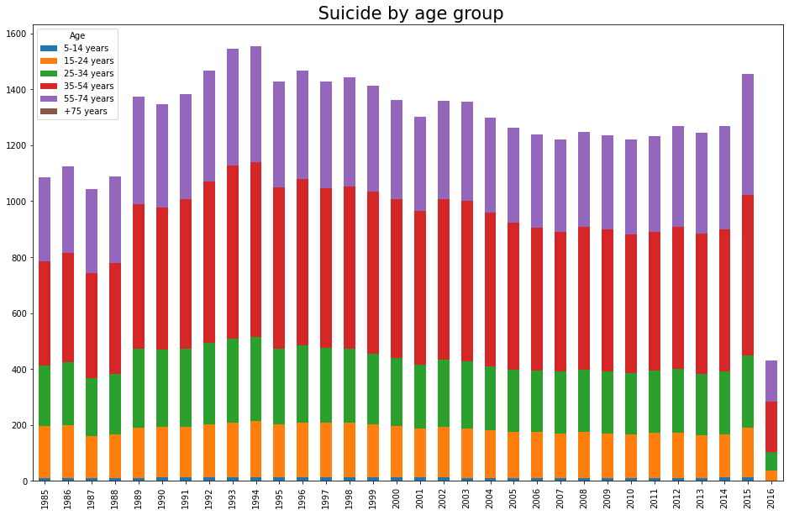
03
Exploratory Data Analysis
Note: Better you zoom of the graphs
The average suicide rate every year from 1985 - 2016 is among the highest among humans aged 55 - 74 years because that age still plays an important role in work or demands a lot and is followed by the second 35 - 54 years old and the lowest rate is the community. who are +75 years old and 5 -14 years old because that's the age they are free from demands.
3.2
Age Group

Slide 7
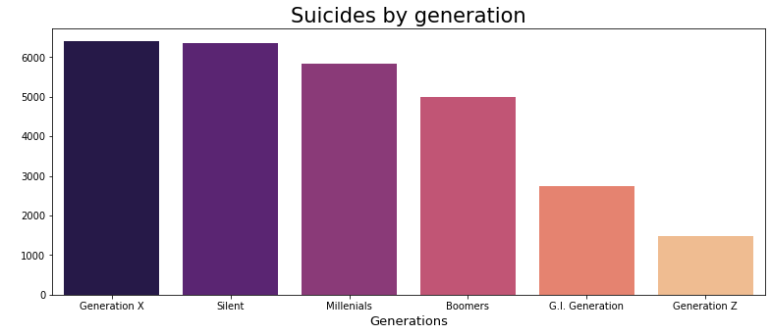
03
Exploratory Data Analysis
Note: Better you zoom of the graphs
The age group with the highest number of suicides was 35 to 54 years old, with 39,930 (36.70%), followed by 25 to 34 years old 26267 from 25 to 34 years old (24.14%).
The Generation with the highest number of suicides recorded was Generation X (23.65%), followed by the Silent Generation (22.04%).
By understanding the age group, we can direct our message more efficiently, as we will focus on those most affected. How to do this? Intensifying campaigns and debates in the places where these people usually go.
By understanding the age group, we can direct our message more efficiently, as we will focus on those most affected. How to do this? Intensifying campaigns and debates in the places where these people usually go.
Generation X: Generation X is an expression that refers to the generation born after the post-World War II baby boom. Although there is no agreement on the period it covers, it generally includes people born from the 1960s to the end of the 1970s. [2]
Silent: Silent Generation is a term used to refer to the population born between 1925 and 1942, namely during the Great Depression and World War II. [3]
Millenials: Generation Y, also called millennial generation, internet generation, or millennials is a concept in Sociology that refers to the court of those born after the early 1980s until, approximately, the end of the century. Some authors consider until 2005. [4]
Boomers: Baby boomers gives name to the generation of people born between the years 1946 and 1964. The expression can be freely translated as "baby boom". The term “explosion” is used here in the sense of “unbridled growth”, which has caused a demographic boom on the planet, especially in the United States. [5]
GI Generation: Greatest generation (in English, Greatest generation) is an expression coined by journalist and writer Tom Brokaw, in his book The Greatest Generation, to refer to the generation formed by individuals who grew up during the Great Depression (1929–39) in United States and later participated in the fighting of the Second World War (1939–45, with participation of the USA between 1941 and 1945), as well as by those who, remaining in the country, participated in the war effort in the so-called home front. [6]
Generation Z: Generation Z is the sociological definition for the generation of people born, on average, between the second half of the 1990s until the beginning of 2010. The theory most accepted by scholars is that it emerged as a succession to Generation Y, from end of 1982 (beginning of Echo Boom). Therefore, it is the generation that corresponds to the idealization and birth of the World Wide Web, created in 1990 by Tim Berners-Lee, and in the "boom" of the creation of modern technological devices. The great nuance of this generation is to zap, having several options, among television channels, internet, video games and smartphones. [7]
3.3
About Generations

Slide 8
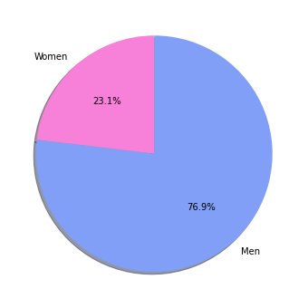
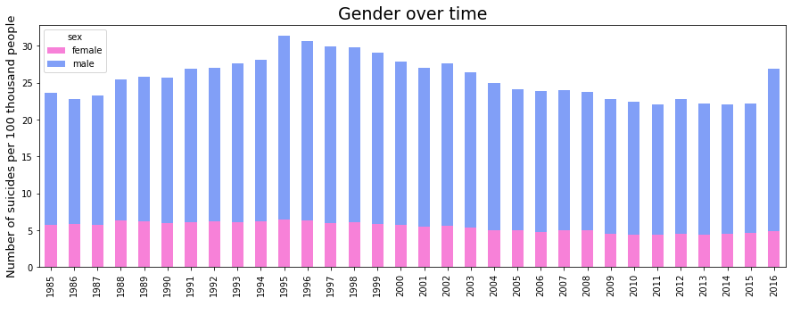
03
Exploratory Data Analysis
Note: Better you zoom of the graphs
A
Gender Mean Suicide
Men commit suicide 3.62 times more than women, and as we can see in the graph below, this pattern has been repeated over time.
Gender Over Time
B
It seems that in terms of gender, men are quite stagnant in the number of suicides, in other words, the highest stress level is obtained by men.
3.4
Gender

Slide 9
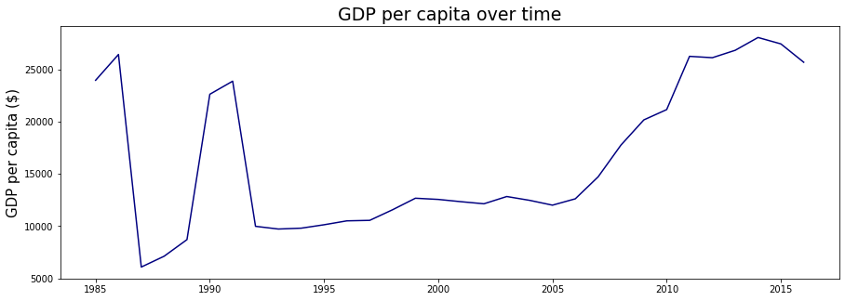
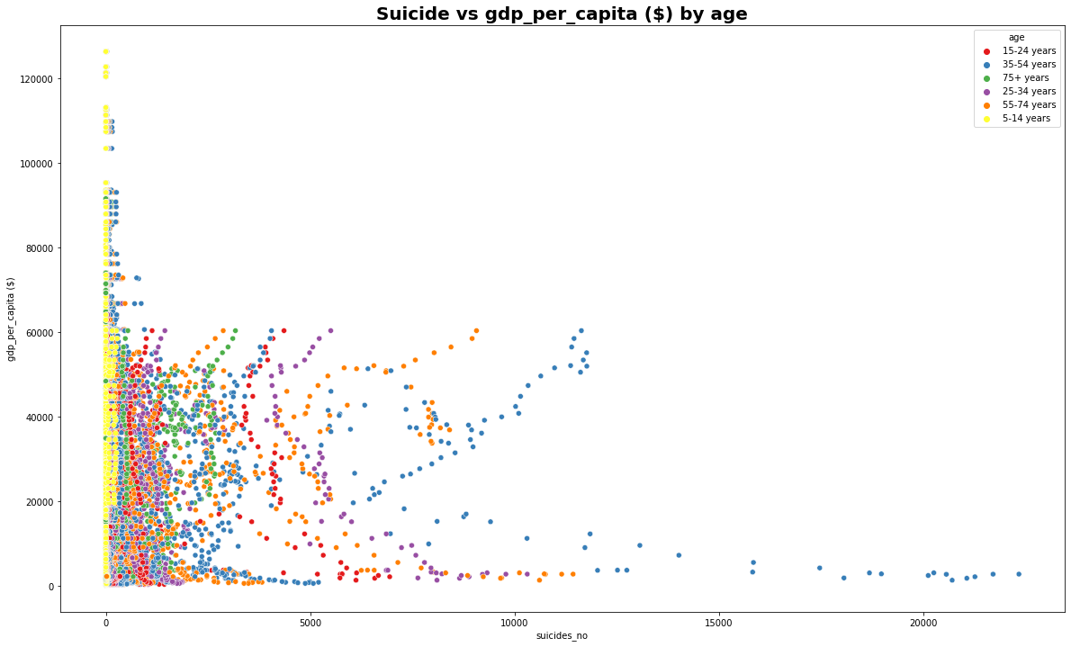
03
Exploratory Data Analysis
Note: Better you zoom of the graphs
GDP per capita over time
We look at the graph above carefully, showing that from 1985 - 1992 between those years the GDP per capita over time rate was looks very volatile, it was possible that the industrial revolution at that time also had an effect on suicide. after 1993 - 2015 the graph has been sloping but the trend is still rising, the rally started in 2006 - 2010 where the internet era in that year appeared so that world income rose dramatically.
01
Suicide vs GDP per capita ($) by age
Wow, it's really surprising that it is actually those aged 5 - 14 who have very large incomes on this data, in other words, there are a lot of young executives in Generation Z.
It is clear that those who have a low GDP per capita tend to have a very high probability of committing suicide, also with a medium GDP per capita, the probability of committing suicide is also moderate, in other words GDP per capita in the world affects the happiness of people around the world.
02
3.5
Economics Data

Slide 10
2022
THANK YOU
Suitable for application for becoming a Data Science staff.
Reporter: Enggar Kristian

